Slide 1
Data Structures
Lecture 5
Stack
Prantik Paul [PNP]
Lecturer
Department of Computer Science and Engineering
BRAC University

Slide 2
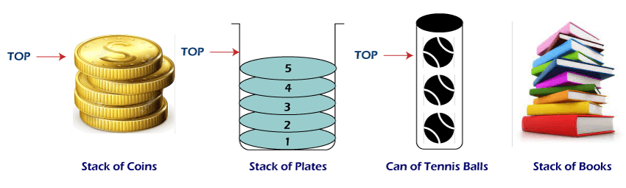
Stack (In Real life)

Slide 3
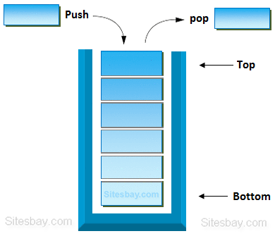
Stack (In Data Structure)

Slide 4
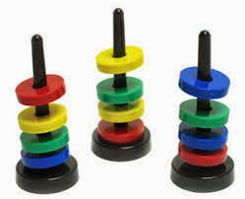
Stack (In CS Problems)

Slide 5
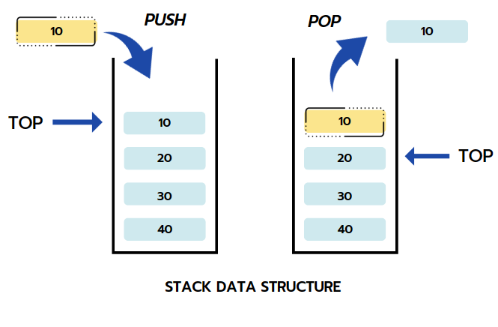
Stack (Basic Actions)

Slide 6
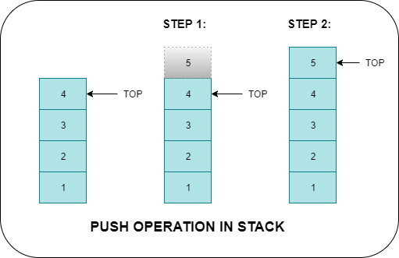
Stack (Push Operation)

Slide 7
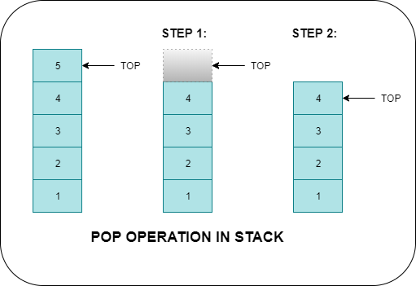
Stack (Pop Operation)

Slide 8
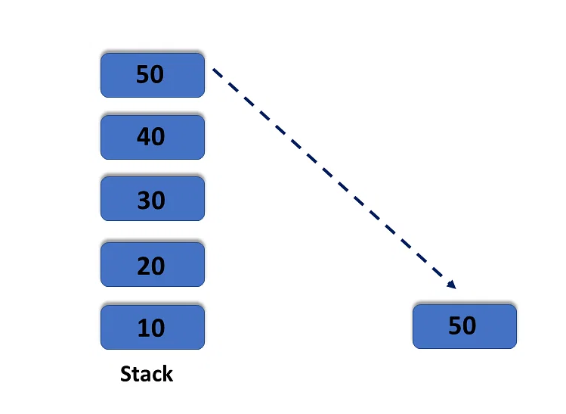
Stack (Peek Operation)

Slide 9
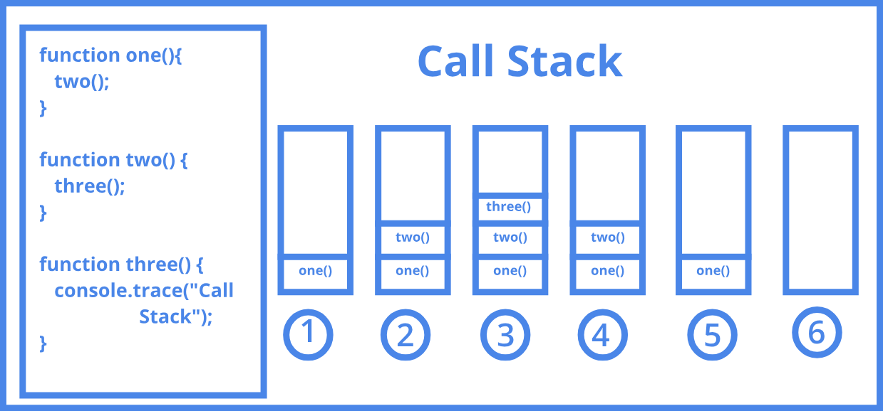
Stack Applications (Call Stack)

Slide 10
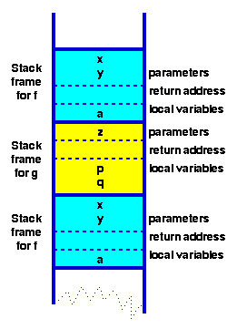
Stack Applications (Function Stack)

Slide 11
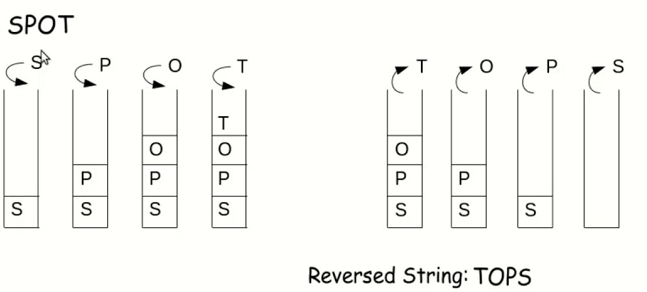
Stack Applications (Reverse String)

Slide 12
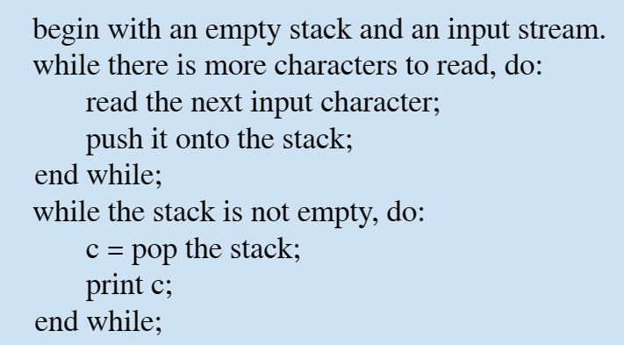
Stack Applications (Reverse String)

Slide 13
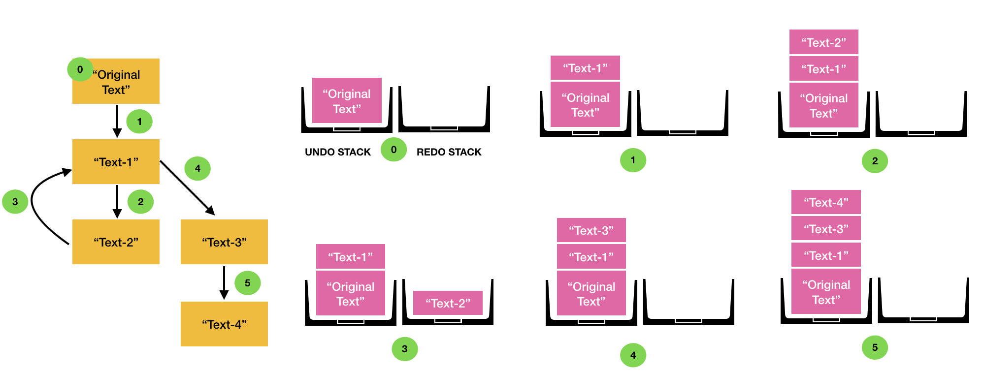
Stack Applications (Undo Operation)

Slide 14
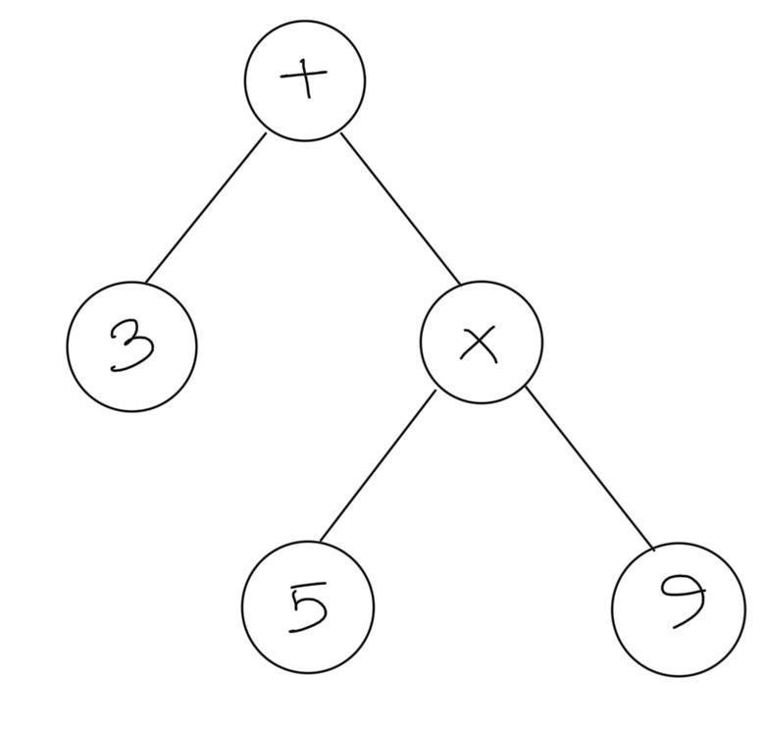
Stack Applications (Postfix Notation)
3 + 5 * 9
3 5 9 * +

Slide 15
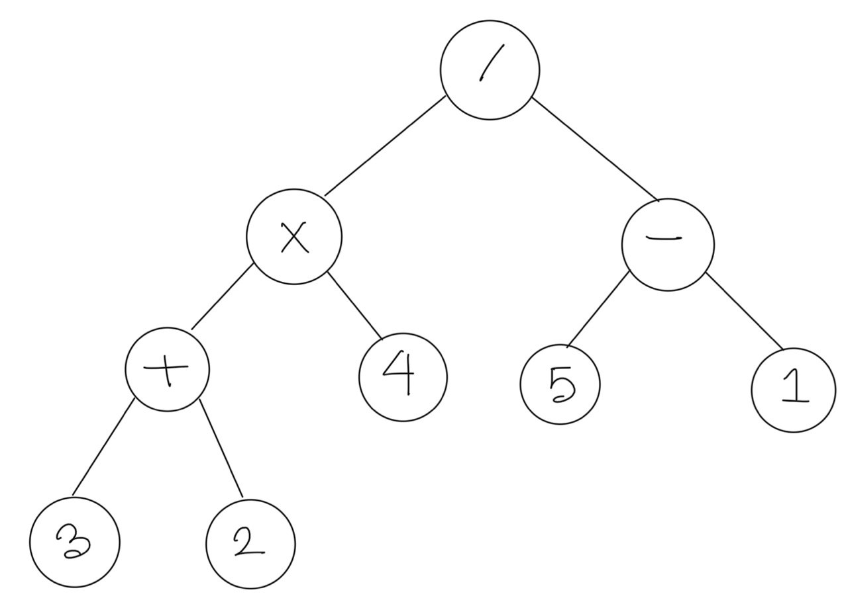
Stack Applications (Postfix Notation)
((3 + 2) * 4) / (5 - 1)
3 2 + 4 * 5 1 - /

Slide 16
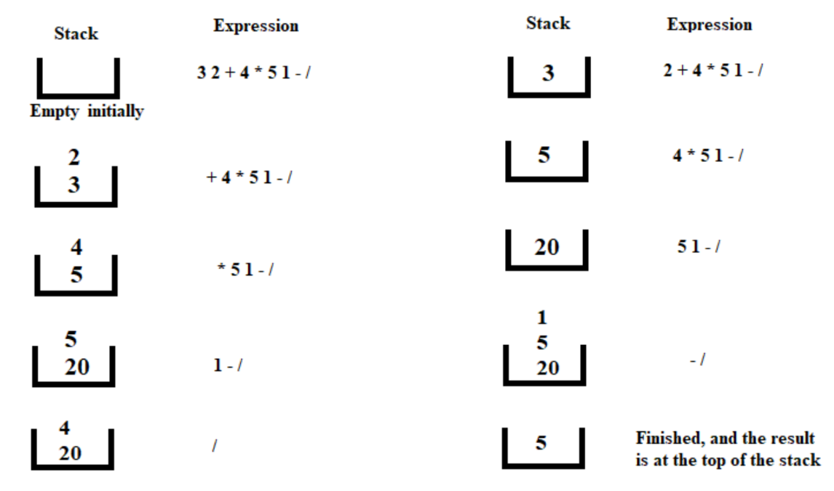
Stack Applications (Expression Evaluation)
3 2 + 4 * 5 1 - /

Slide 17
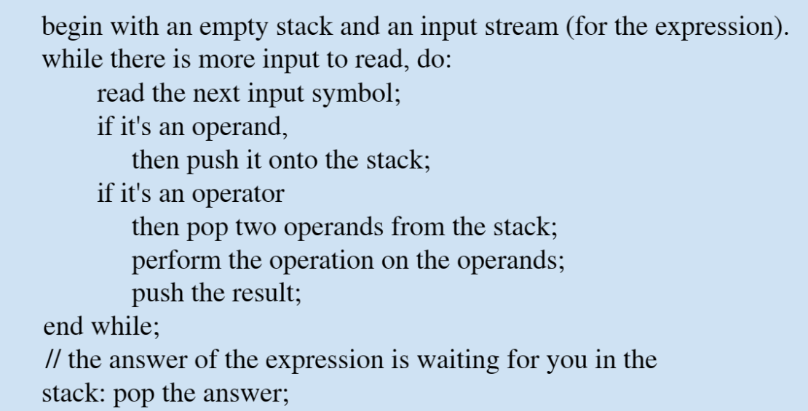
Stack Applications (Expression Evaluation)

Slide 18
Stack Applications (Parenthesis Matching)
(a (b + c) + d)
(a (b + c) + d
[ (a b) (c d) ]
[ (a b] (c d) )
( [a {x y} b] )
( [a {x y) b] )
Correct
Incorrect

Slide 19
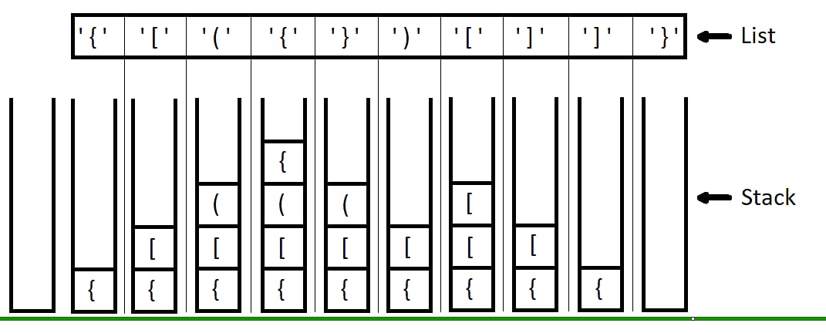
Stack Applications (Parenthesis Matching)

Slide 20
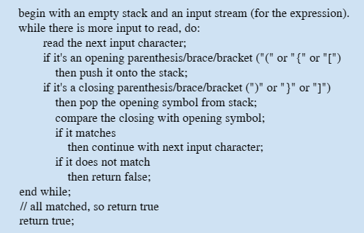
Stack Applications (Parenthesis Matching)

Slide 21
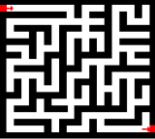
Stack Applications (BackTracking - Maze)

Slide 22
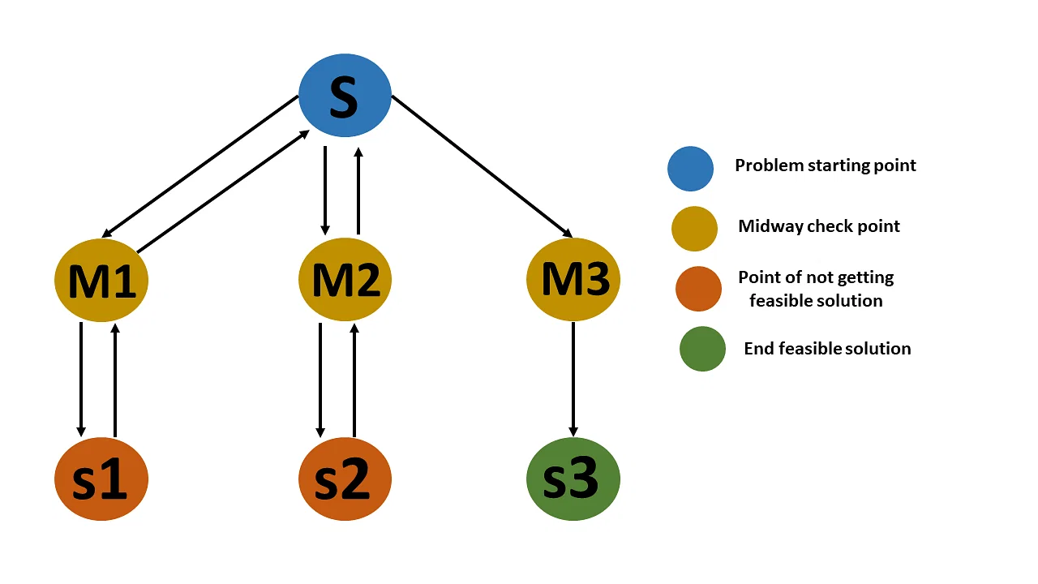
Stack Applications (BackTracking)

Slide 23
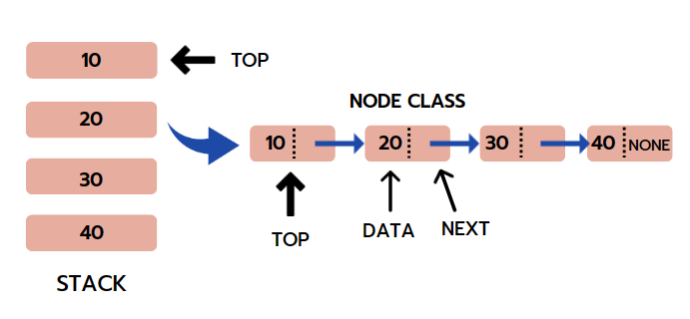
Stack Implementation (with Linked List)

Slide 24
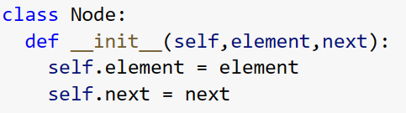
Stack Implementation (Node Class)

Slide 25
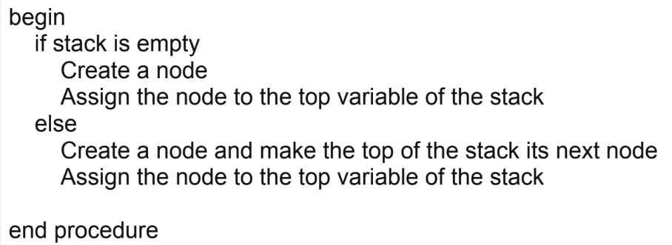
Stack Implementation (Push Operation)

Slide 26
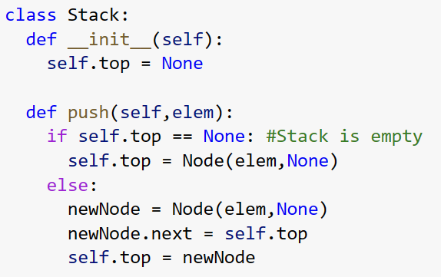
Stack Implementation (Push Operation)

Slide 27
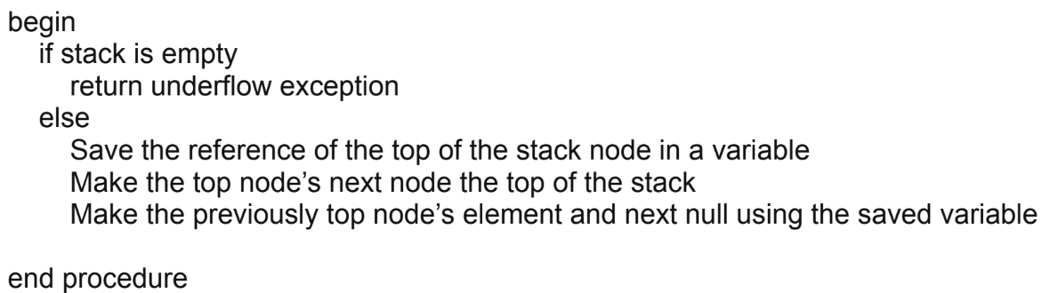
Stack Implementation (Pop Operation)

Slide 28
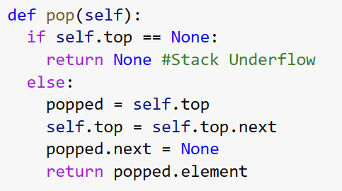
Stack Implementation (Pop Operation)

Slide 29
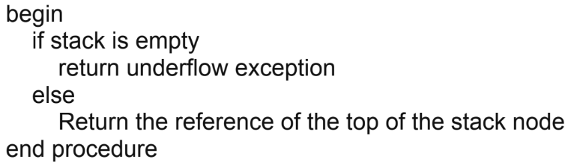
Stack Implementation (Peek Operation)

Slide 30
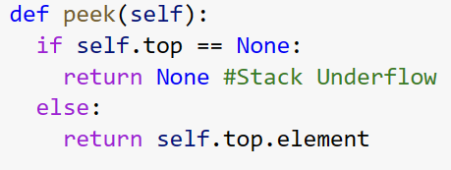
Stack Implementation (Peek Operation)

Slide 31
Stack Problems
Count the elements of a stack

Slide 32
Stack Application
Reverse a Number using Stack

Slide 33
Stack Problems
Delete the third element from the stack

Slide 34
Stack Problems
Mid reversal of stack
6
3
5
2
4
1
3
6
2
5
1
4

Slide 35
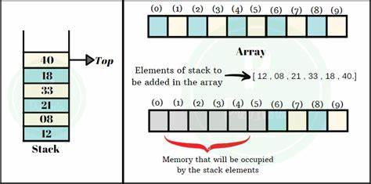
Stack Implementation (with Array)

